Slide 1
Final Project
Eric M. Abitbol

Slide 2
Introduction
A Hair Salon in Toronto is faced with no-shows and late cancellations 8%.
Objective: Build a predictive model that enables to detect a day before the potential bookings that can result in a noshow.
Prevention/solutions to reduce noshow rate after detection are out of scope
Data Source Kaggle.

Slide 3
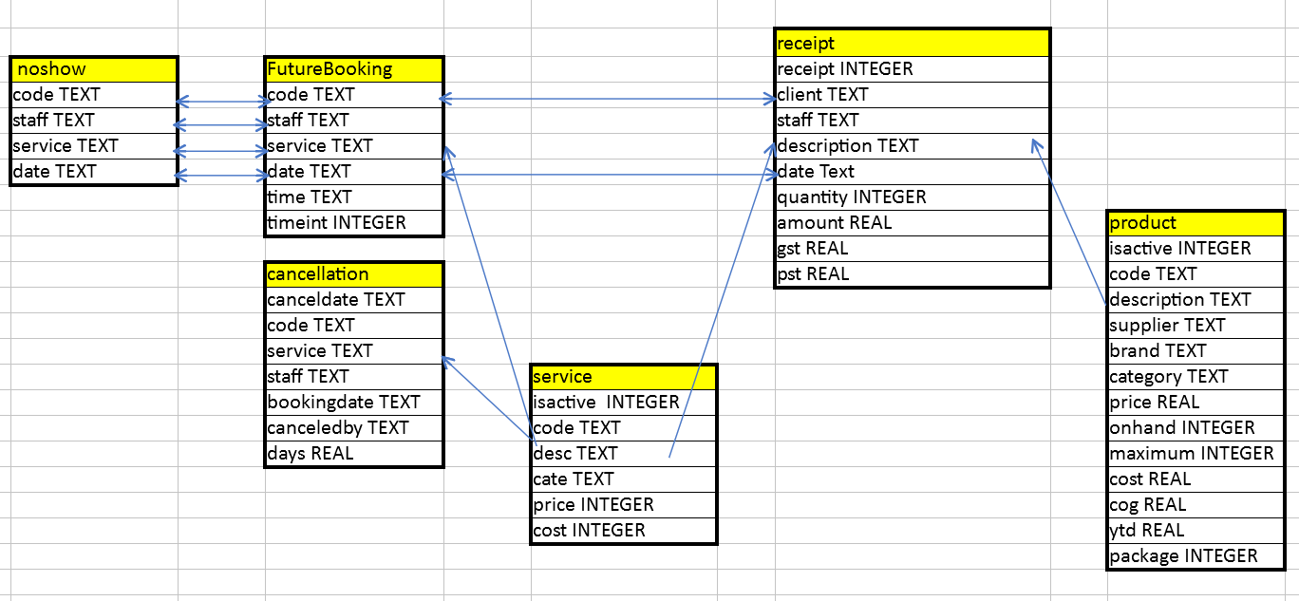


Data
Data CSV files → uploaded to Sqlite DB
External Data: Holidays in Toronto. (cancellations on Monday or on holidays are considered as no-shows)

Slide 4
Data – Features
Booked Staff
Week in month (1..5)
Day in week (Tuesday to Sunday)
Hour
Day Hour combination
Average price of booked service
Multiple appointment indicator
Booked Service Type
Booked Service
First appearance
Previous no show
Existing Customer
Last Booked Staff
Last60days total bills , discounts [0 1]
Last60days color, product bills [0 1]
Last90days product buyer
Active bundle promo
Average price of previous service
#days since last effective appointment
#days since last noshow
#early cancellations in last 60 days
#eve cancleastions in last 60 days
Last effective booking day in week
Last effective booking hour
176 features after hot encoding of multi-class feature

Slide 5
EDA
No-show for existing customers depends on prices of ordered services
Distribution of days and hours where no show are likely to happen
Employee impact on no-shows

Slide 6
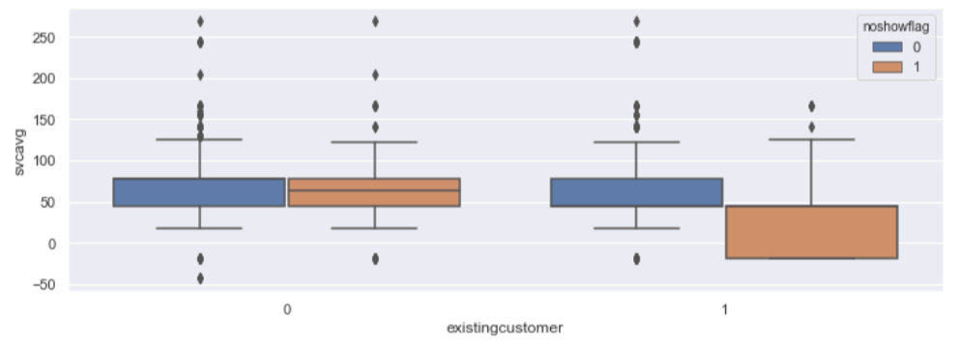
EDA NoShow Vs Service

Slide 7
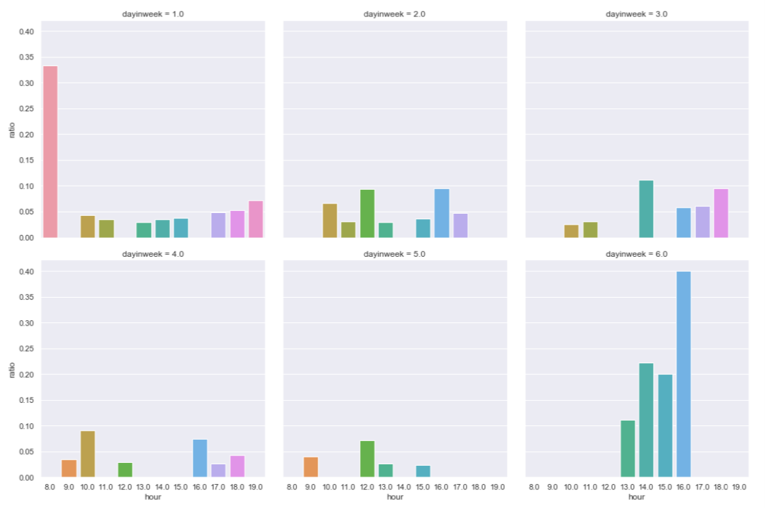
EDA No Show distribution

Slide 8
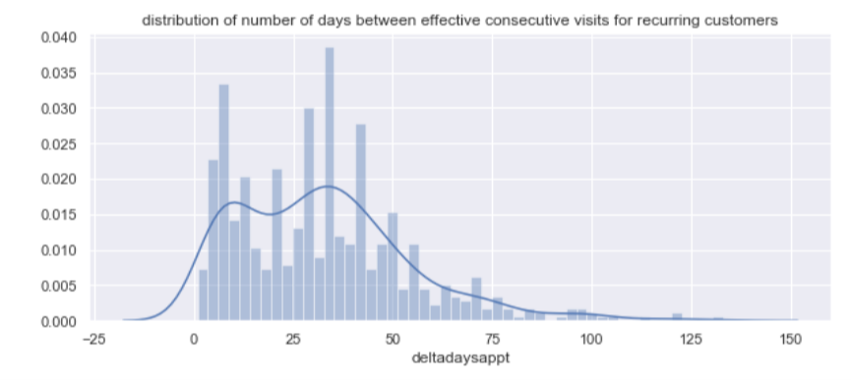
EDA 60 days history window

Slide 9
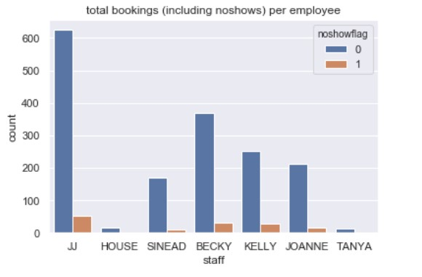
EDA Employee vs noshow

Slide 10
Outliers & Missing
Outliers
only one continuous variable receipt amount no outlier
one appointment on Monday - VIP- removed
Missing Values
Missing Hour for all cancellations occurring on booking day
Missing not at random
Assumption: same distribution as other appointments – to be discussed
KNN Classifier for hour based on employee, month, week and weekday
For employees with 2 canceled appointments
1st is set with KNN based employee , month, week, day in week.
2nd is set with Radius Center Neighboring based on employee, day in week

Slide 11
Feature selection
Models comparison
Univariate, Logistic Regresion L1, Decision Tree, Random Forest,
SVM, Adaboost, Gradient boosting, Xgb
At least 4.
Cut-off Value : at least present in 4 models
39 features (out of 176) - 22%

Slide 12
Dataset partition
3 balanced datasets Train, Dev, Test
Training Rose Generated *1.8 – Positive Negative50/50)
Dev cross validation training
Test final validation of fine tuned model
Proportion 60/15/25 %
Balancing by checking no significant feature between datasets Table 1

Slide 13
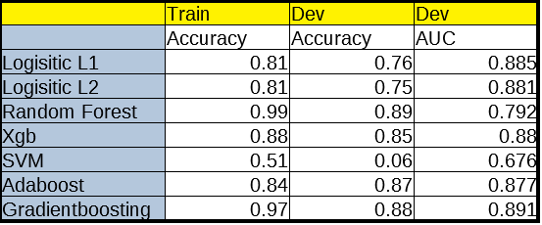
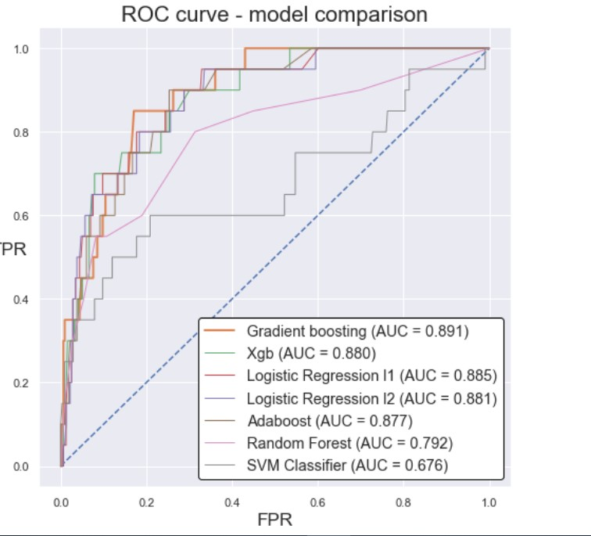
Model selection
Selection based on AUC

Slide 14
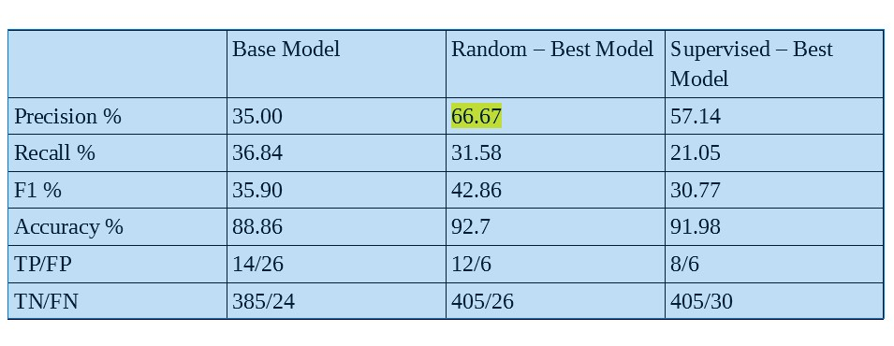
Model Fine-tuning
Random and Grid Search with cross validation with dev and selection on test
Hyper parameters
Learning Rate, n_estimators , criterion, max_depth, n_estimators
Max features, min samples split,min sample leaf
n_iter_no_change, tol [early stopping]

Slide 15
Conclusion
Data analysis and cleaning is the longest phase
Understanding model limits based on provided data
Understanding dilemmas posed by selection criteria
Learning while practicing

